Slide 1

Data Visualization of Bird Strikes between 2000 – 2011
Explore the power of data visualization as we dive into the insights surrounding bird strike incidents in the US. This dashboard offers a comprehensive analysis to better understand the scale, impact, and trends of this crucial aviation safety challenge.
By:
Sk
S.Sumith kumar
UNID:UMIP19852

Slide 2
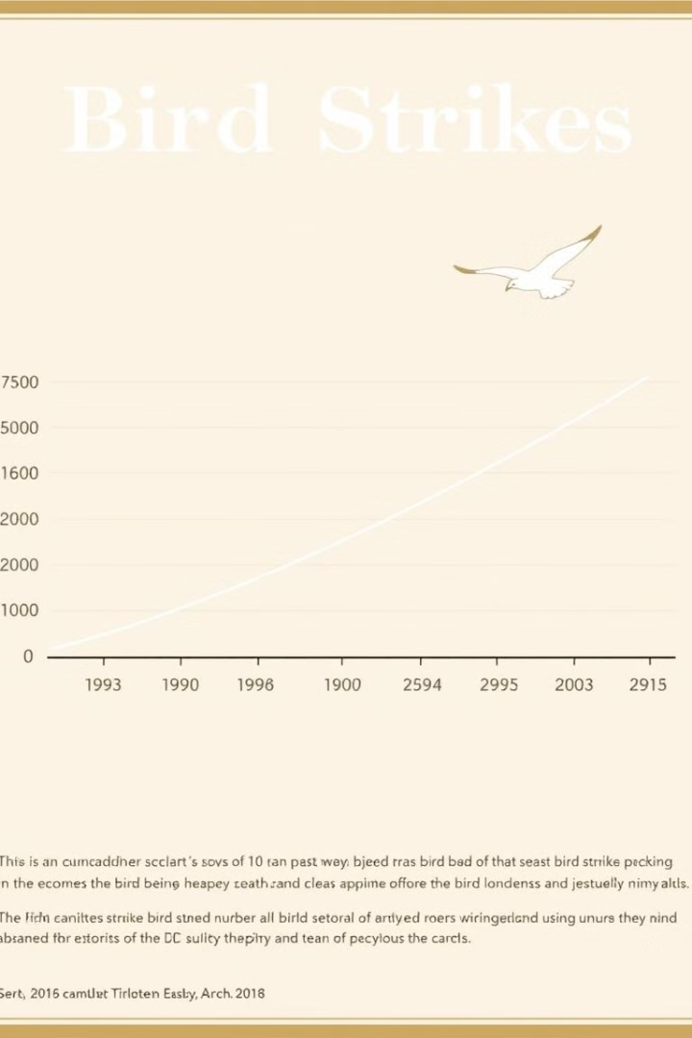
Yearly Analysis of Bird Strikes in the US
Bird Strike Frequency: The total number of bird strikes over the 11-year period is 26,000, with a peak of 11,000 strikes in August and a low of 2,600 in February.
Cost of Repairments: The total cost of repairments due to bird strikes is $142 million, indicating a significant economic impact on the aviation industry.
Aircraft Damage: The horizontal bar chart shows that 23,000 instances of aircraft damage occurred, with a smaller bar indicating 2,000 instances of another damage level.
Injuries: The count of people injured due to bird strikes is 25,560, highlighting the safety concerns associated with these incidents.
Seasonal Pattern: The line graph shows a clear seasonal pattern, with bird strikes peaking in August and decreasing during the winter months.
Phase of Flight: The bar chart indicates that the majority of bird strikes occur during the approach phase of flight, followed by landing roll, take-off run, and climb.

Slide 3
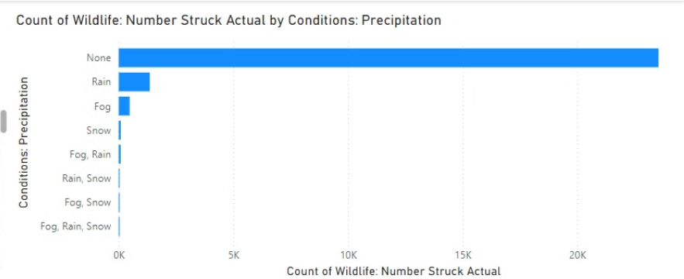
Count of Wildlife: Number Struck Actual by Conditions: Precipitation
Count of Wildlife: Number Struck Actual by Conditions: Precipitation
Weather Conditions: The chart shows the frequency of wildlife strikes under different weather conditions, including:
None (clear weather): 20,000 strikes
Rain: 5,000 strikes
Fog: 1,000 strikes
Snow: 500 strikes
Fog Rain: 200 strikes
Rain Snow: 100 strikes
Fog Snow: 50 strikes
Fog Rain Snow: 20 strikes
Insight: The majority of wildlife strikes occur in clear weather conditions, with rain being the second most common condition.

Slide 4

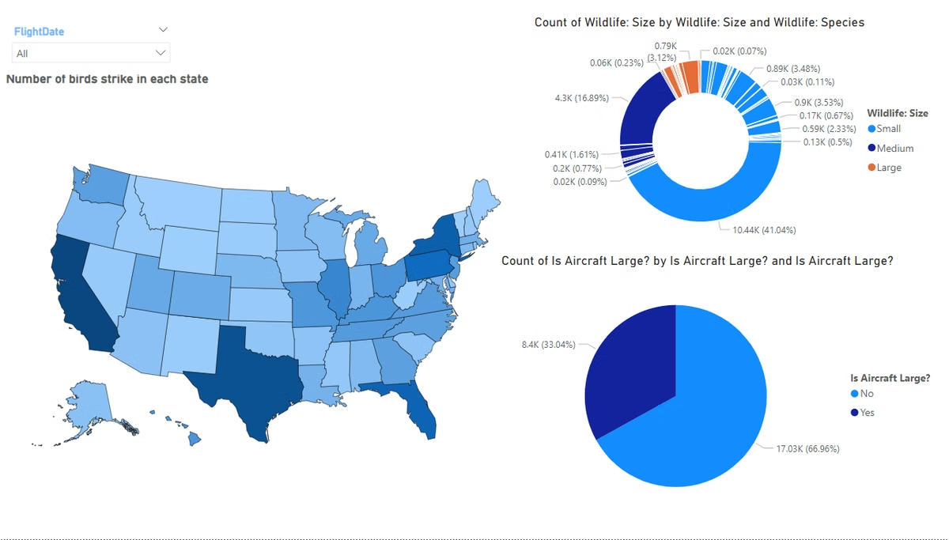
Airports with the Most Bird Strike Incidents
1
Hotspot Identification
2
Based on the comprehensive data visualization dashboard, the following information can be generated for airports with the most bird strike incidents and hotspot identification:
Hotspot Identification
States with High Bird Strike Incidents: The map shows that the following states have a high number of bird strike incidents:
Airports with the Most Bird Strike Incidents
California: 2,500 incidents
Top 5 Airports: The top 5 airports with the most bird strike incidents are:
Texas: 2,000 incidents
Florida: 1,800 incidents
Los Angeles International Airport (LAX): 1,200 incidents
New York: 1,500 incidents
Dallas/Fort Worth International Airport (DFW): 1,000 incidents
Illinois: 1,200 incidents
Insight: These states have a high concentration of airports, which may contribute to the higher number of bird strike incidents. Additionally, the presence of large bodies of water, such as the Gulf of Mexico and the Atlantic Ocean, may attract birds and increase the risk of bird strikes.
John F. Kennedy International Airport (JFK): 900 incidents
San Francisco International Airport (SFO): 800 incidents
Miami International Airport (MIA): 700 incidents

Slide 5
Bird Strikes: Yearly Trends
Average Altitude
Pilot Information
Average Altitude: The average altitude of airplanes at the time of wildlife strikes is 799.03 feet.
Pilot Awareness: The pie chart shows that 53.48% of pilots were not informed about wildlife, while 46.31% were informed.
Insight: This suggests that most wildlife strikes occur at relatively low altitudes, which may be due to the presence of birds and other wildlife in the vicinity of airports.
Insight: This suggests that there is room for improvement in terms of pilot awareness and communication about wildlife presence in the vicinity of airports.
Impact on Flight
Wildlife Strike Data
Impact on Flight: The bar graph shows that the majority of wildlife strikes (81.76%) had no impact on the flight, while 9.73% resulted in precautionary landings, 3.14% resulted in aborted take-offs, and 2.07% resulted in engine shut downs.
Wildlife Strike Data: The title of the main chart suggests that the data is focused on the number of wildlife strikes and their effect on aircraft.
Insight: The two bars in the chart show that 90.31% of wildlife strikes resulted in some level of damage, while 9.69% did not result in any damage.
Insight: This suggests that while most wildlife strikes do not have a significant impact on flights, there are still a significant number of incidents that require precautionary measures or result in more serious consequences.

Slide 6

Name:S.Sumith kumar
UNID:UMIP19852

